Slide 1
Lecture 10:
Training Neural Networks
Part IV

Slide 2
Evaluation:
Model Ensembles

Slide 3
Train multiple independent models
At test time average their results
Enjoy 2% extra performance (?!!!)

Slide 4
Fun Tips/Tricks:
can also get a small boost from averaging multiple model checkpoints of a single model.

Slide 5
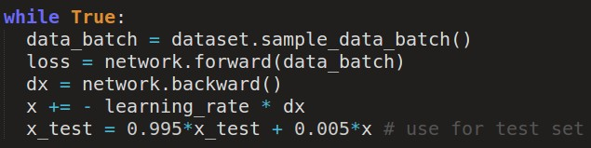
Fun Tips/Tricks:
can also get a small boost from averaging multiple model checkpoints of a single model.
keep track of (and use at test time) a running average
parameter vector:

Slide 6
Regularization (dropout)

Slide 7
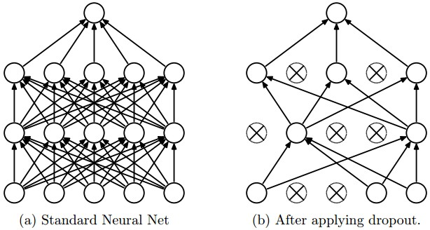
Regularization: Dropout
“randomly set some neurons to zero in the forward pass”
[Srivastava et al., 2014]

Slide 8
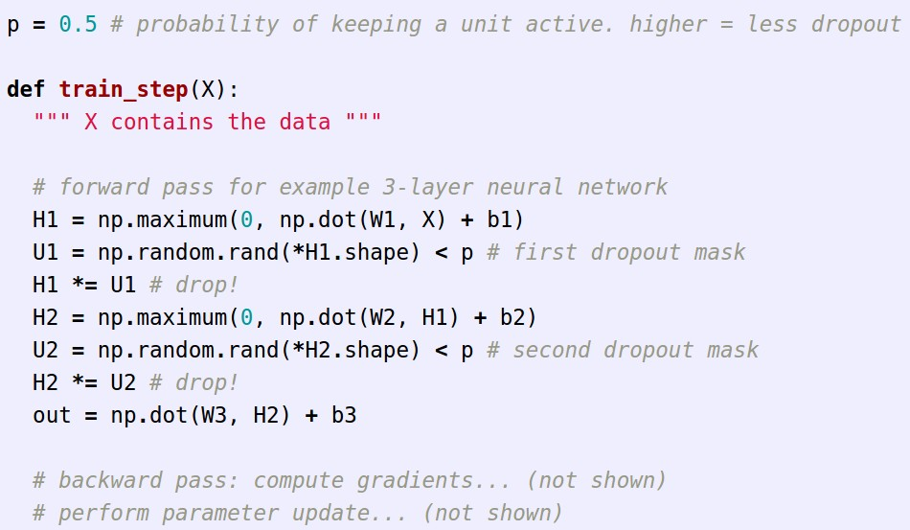
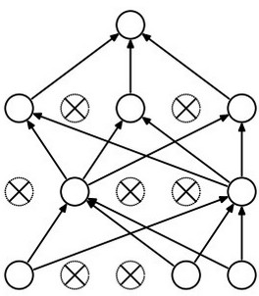
Example forward pass with a 3-layer network using dropout

Slide 9
Waaaait a second…
How could this possibly be a good idea?

Slide 10
Waaaait a second…
How could this possibly be a good idea?
Forces the network to have a redundant representation.
has an ear
X
has a tail
is furry
X
cat
score
has claws
X
mischievous
look

Slide 11









Training with occlusions?

Slide 12
Waaaait a second…
How could this possibly be a good idea?
Another interpretation:
Dropout is training a large ensemble of models (that share parameters).
Each binary mask is one model, gets trained on only ~one datapoint.

Slide 13
At test time….
Ideally:
want to integrate out all the noise
Monte Carlo approximation:
do many forward passes with different dropout masks, average all predictions

Slide 14
At test time….
Can in fact do this with a single forward pass! (approximately)
Leave all input neurons turned on (no dropout).
(this can be shown to be an approximation to evaluating the whole ensemble)

Slide 15
At test time….
Can in fact do this with a single forward pass! (approximately)
Leave all input neurons turned on (no dropout).
Q: Suppose that with all inputs present at test time the output of this neuron is x.
What would its output be during training time, in expectation? (e.g. if p = 0.5)

Slide 16
At test time….
Can in fact do this with a single forward pass! (approximately)
Leave all input neurons turned on (no dropout).
during test: a = w0*x + w1*y
during train:
E[a] = ¼ * (w0*0 + w1*0
w0*0 + w1*y
w0*x + w1*0
w0*x + w1*y)
= ¼ * (2 w0*x + 2 w1*y)
= ½ * (w0*x + w1*y)
a
w1
w0
x
y

Slide 17
At test time….
Can in fact do this with a single forward pass! (approximately)
Leave all input neurons turned on (no dropout).
during test: a = w0*x + w1*y
during train:
E[a] = ¼ * (w0*0 + w1*0
w0*0 + w1*y
w0*x + w1*0
w0*x + w1*y)
= ¼ * (2 w0*x + 2 w1*y)
= ½ * (w0*x + w1*y)
With p=0.5, using all inputs in the forward pass would inflate the activations by 2x from what the network was “used to” during training!
=> Have to compensate by scaling the activations back down by ½
a
w1
w0
x
y

Slide 18
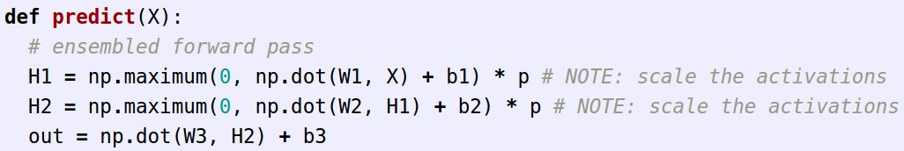
We can do something approximate analytically
At test time all neurons are active always
=> We must scale the activations so that for each neuron:
output at test time = expected output at training time

Slide 19
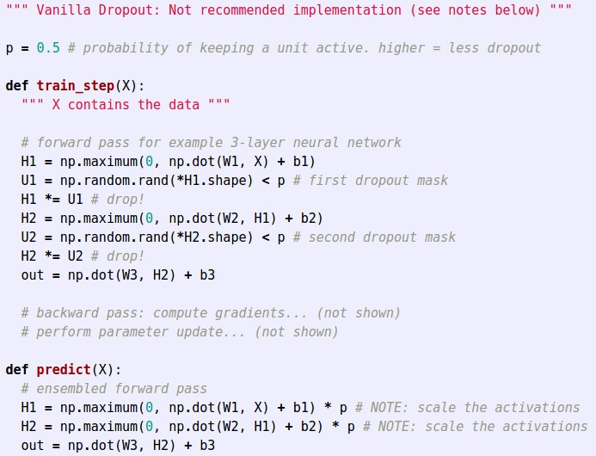
Dropout Summary
drop in forward pass
scale at test time

Slide 20
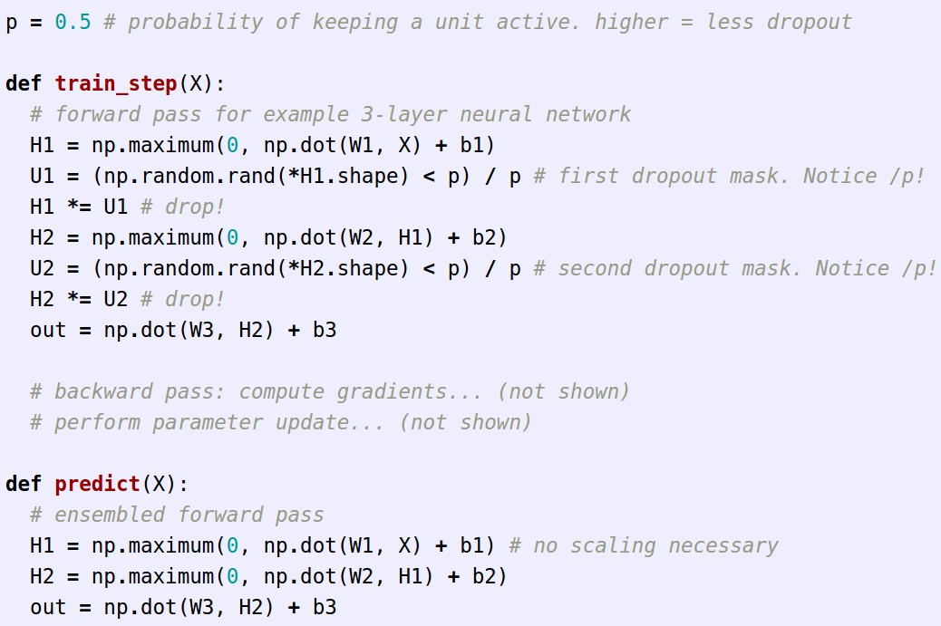
More common: “Inverted dropout”
test time is unchanged!

Slide 21
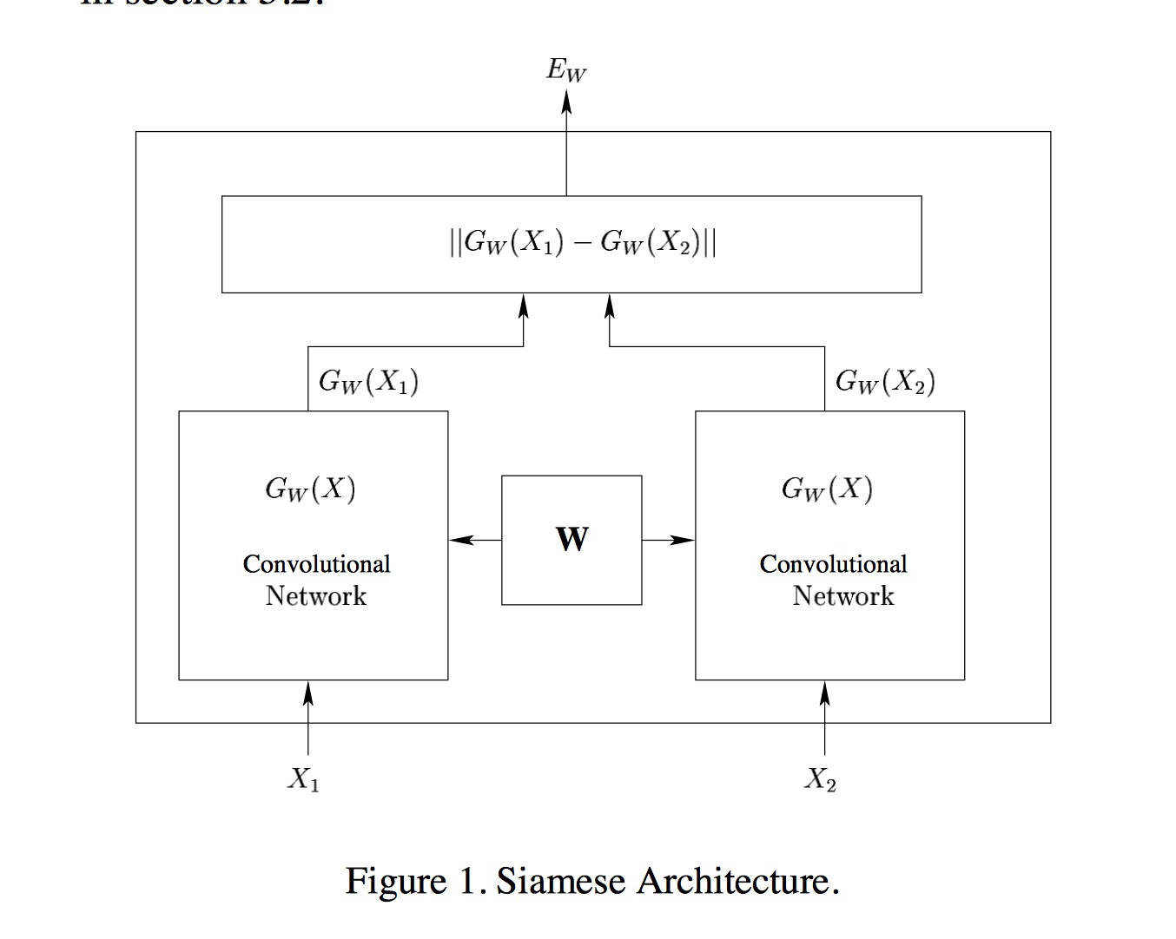

Slide 22
Siamese Networks (conjoined networks):
Train a network on classification task.
Chop off classification layer.
Make two copies of the “beheaded network”.
Put one image into each network.
Calculate “distance” between two CNN vectors.
If distance is greater than threshold, say images are “different”. Otherwise, “same”.

